Slide 1
Result of
Season 7 Session 1
Algorithm and Flowchart
The Software Club

Slide 2
Marks
Position | Name | Problem Solving (10) | Optimization (6) | F and A Standards (4) | Total (20)
5 | Anushka Maharjan | 3 | 3 | 2 | 8
6 | Prayush Shrestha | 3 | 2 | 2 | 7
7 | Asmita Bista | 3 | 2 | 2 | 7
8 | Anil Parajuli | 2 | 2 | 2 | 6

Slide 3
Marks
Position | Name | Problem Solving (10) | Optimization (6) | F and A Standards (4) | Total (20)
2 | Mallika Bhattarai | 8 | 4 | 4 | 16
3 | Biplav Shrestha | 7 | 3 | 3 | 13
4 | Umesh Dhungana | 10 | 0 | 2 | 12

Slide 4
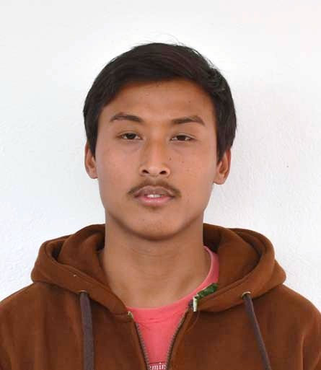
Winner
1st Suman Maharjan
Problem Solving(10) | Optimization (6) | F and A Standard (4) | Total
9 | 5 | 4 | 18

Slide 5
Question
Write an algorithm and draw a flowchart which gives output of any given expression.
[E.g. If user gives input 5 x 2 – 3 then output should be 7.]

